Slide 1

Rainwater Harvesting For Domestic Use In Ireland
Bachelor of Engineering Technology Building Services Engineering
Cathal McDermott
Dublin Institute of Technology
2012 CIBSE AWARDS

Slide 2
Contents
What is Rainwater Harvesting?
Irelands climate
Water Usage
Types of rainwater harvesting systems
Components of a rainwater harvesting system
Case studies
Conclusion

Slide 3
What is Rainwater Harvesting?
Rainwater Harvesting is a technology used for collecting and storing rainwater from rooftops, land surfaces or road surfaces using simple techniques such as barrels, tanks and cistern method
Harvested rainwater is a renewable source of clean water that is ideal for domestic and landscape uses

Slide 4
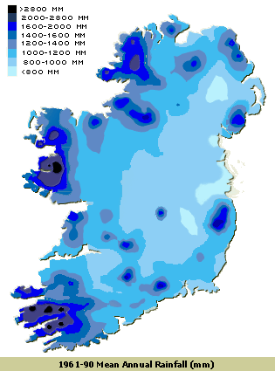
Irelands Climate
Irelands climate is influenced by the Atlantic Ocean
On average it rains 188 days of the year
Rainwater harvesting is ideal for Ireland’s high level of rainfall

Slide 5
Water Use in Ireland

Slide 6
Types of Rainwater Harvesting Systems
Indirectly pumped system
Directly pumped systems
Gravity fed systems

Slide 7
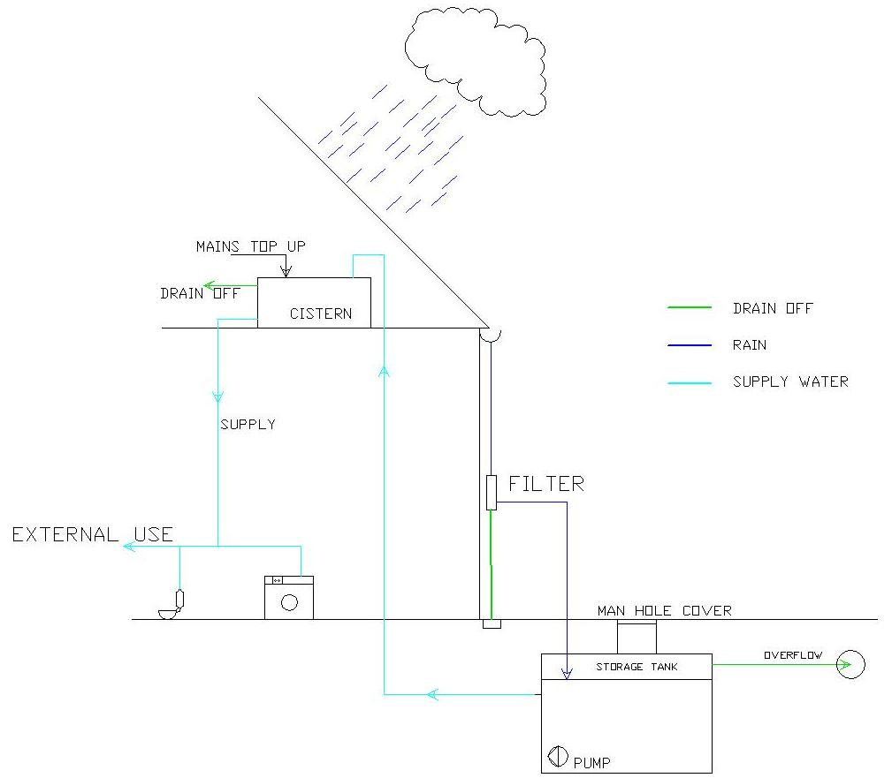
Indirectly Pumped System

Slide 8
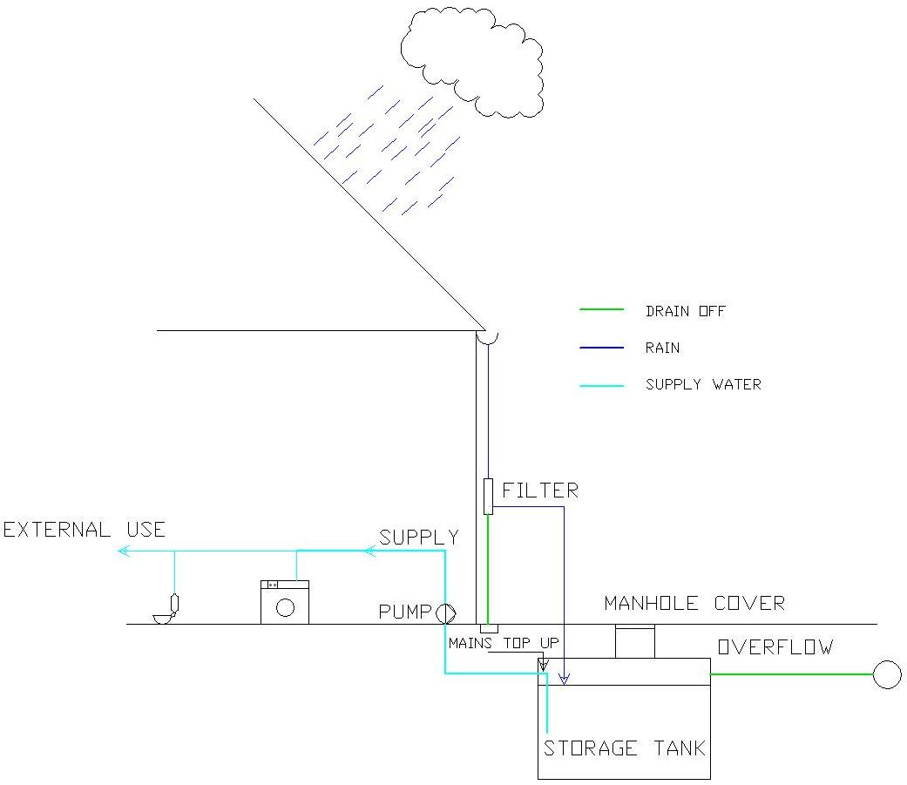
Directly Pumped Systems

Slide 9
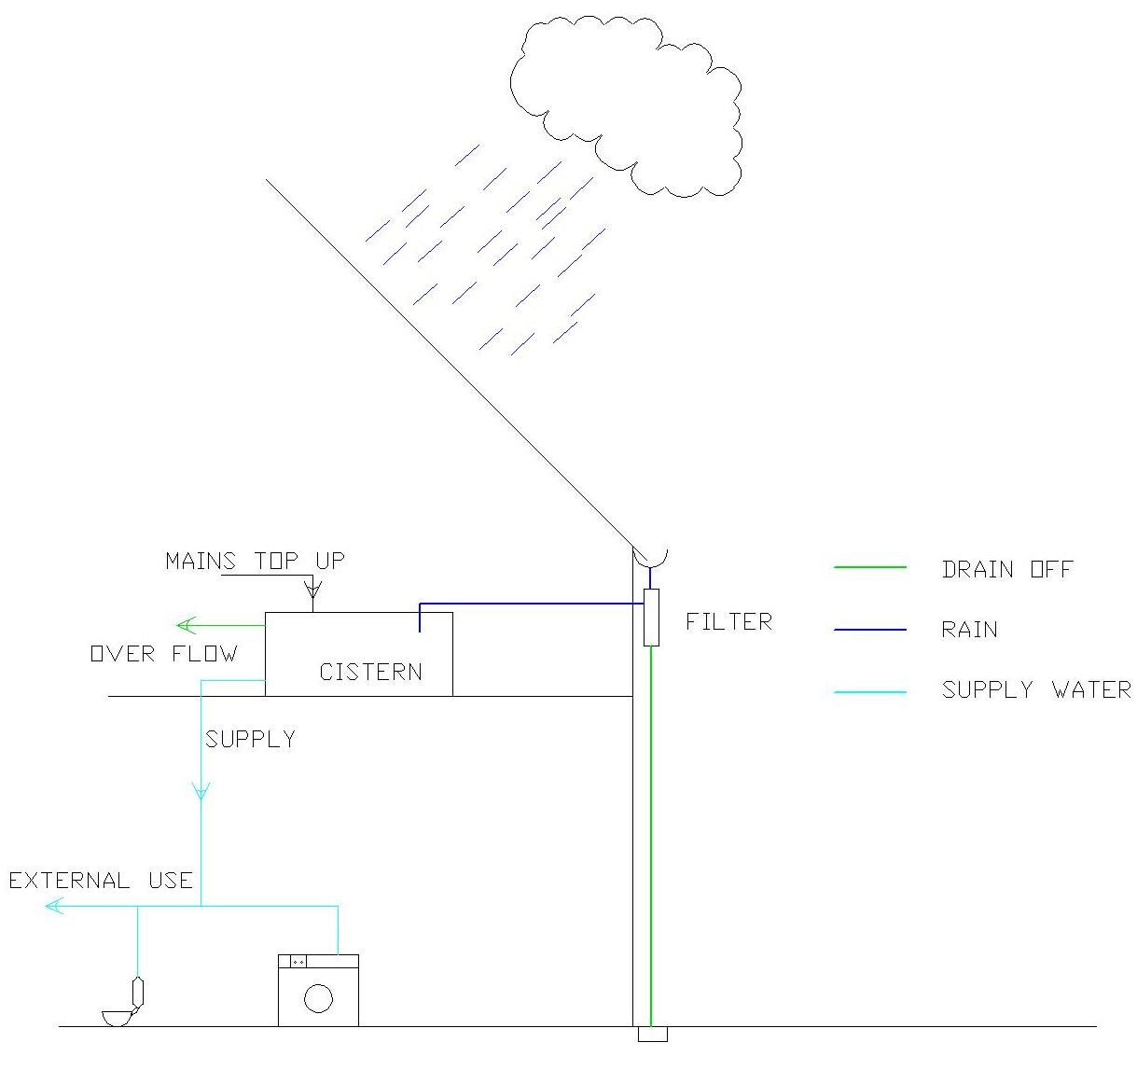
Gravity Fed Systems

Slide 10
Components of a Rainwater Harvesting System
Runoff delivery system
Treatment of Water
Storage tanks
Cistern
Controls

Slide 11
Runoff Delivery System
Rainwater is transferred to the storage tank through:
Gutters
Downpipes
The downpipes and gutters have to regularly maintained
This ensures that the maximum amount of rainfall can be transferred to the storage tank
Typical storage tank size 2-4m³

Slide 12
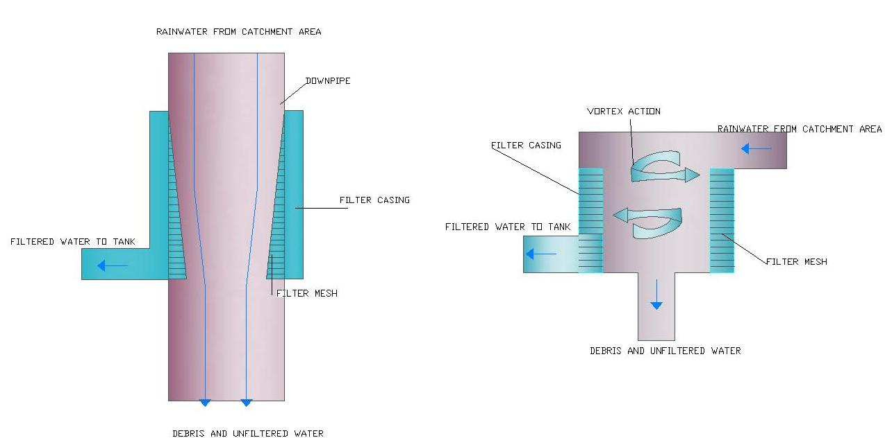
Treatment of Water
Filters
Inline downpipe filters & Subsurface Vortex filter:

Slide 13

Treatment of Water Continued
Filters
Floating Filter
Situated in the storage tank
Protects the pump and distribution pipework from dirt

Slide 14
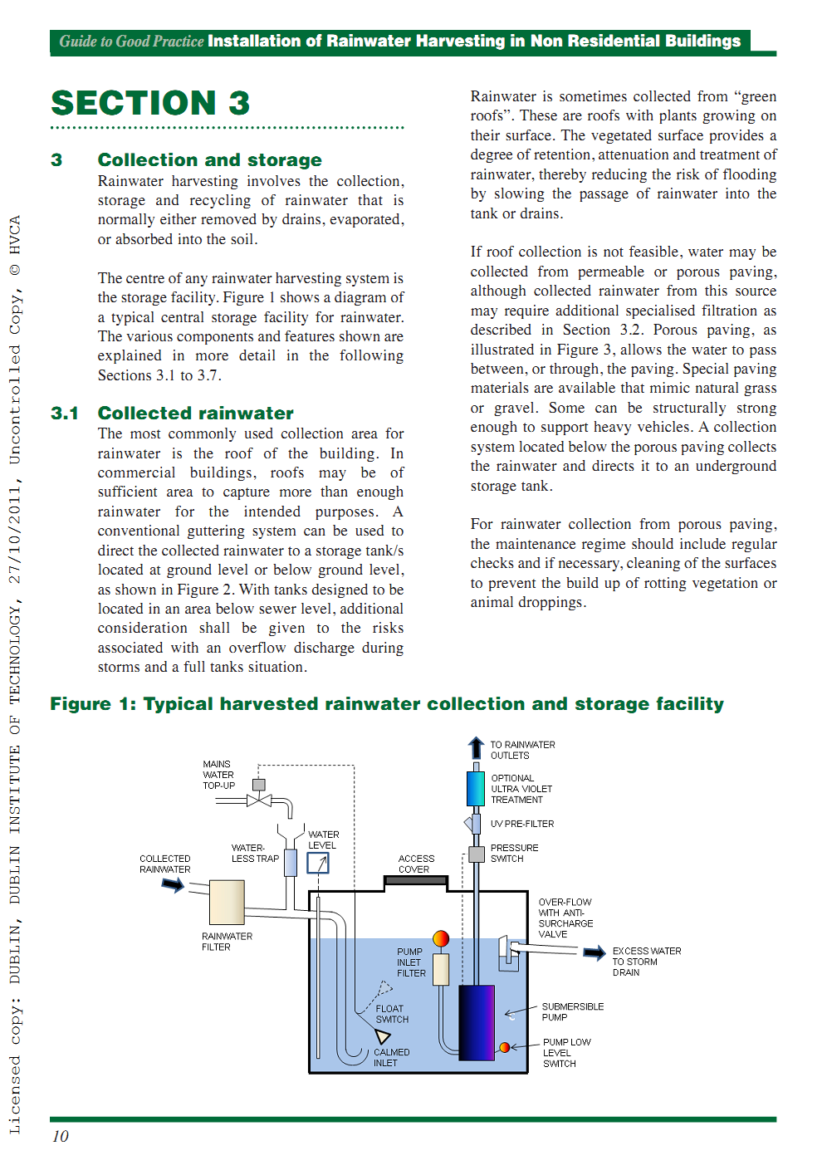
Treatment of Water Continued
Filters
Ultraviolet disinfection
Removal of bacteria from the rainwater.
No residual effect on the water.
Situated in the distribution pipework

Slide 15
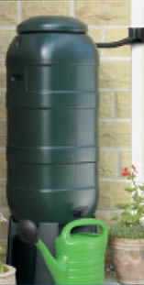
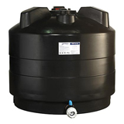
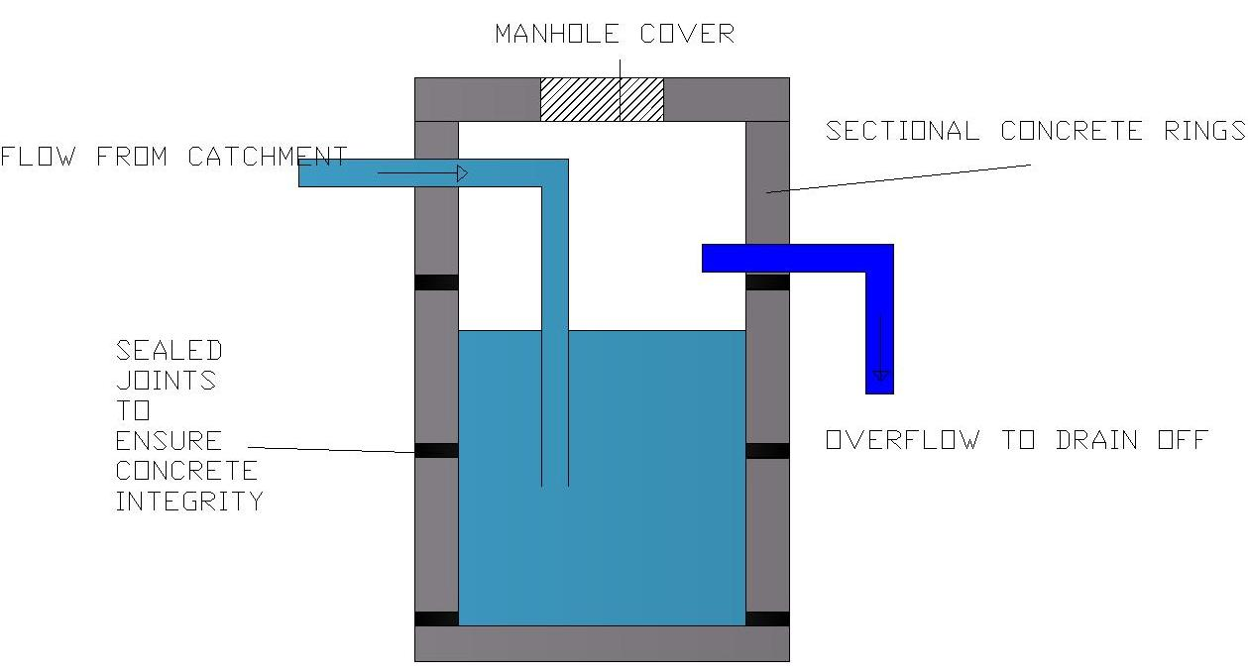
Storage Tanks
Rainwater can be stored in several ways:
1.Water barrel
2.Over Ground tanks
3.Underground tanks

Slide 16
Controls
The control unit for a rainwater harvesting system should incorporate
Control pumps
Insufficient rainwater control monitor
High level alarm
A float switch

Slide 17
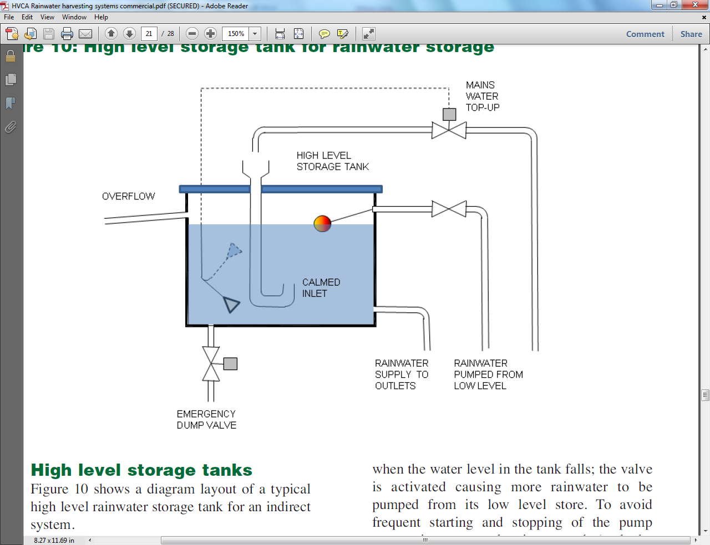
Controls
Float switch

Slide 18
Case studies
Case study 1
A review of a study into the potential for rainwater harvesting in Ireland as an alternative to mains water supply undertaken by a team in DIT led by Dr. Sean O hOgain
Aims of the study
To see if the harvestable rainfall collected could meet the toilet demand of the house
To evaluate the economic basis of installing a rainwater harvesting system for the householder

Slide 19
Case Study 1
Rainfall, harvestable rainfall and toilet demand between March 2006-March 2008
2006 | J | F | M | A | M | J | J | A | S | O | N | D | Total
Rainfall mm |  |  | 91 | 31 | 98 | 28 | 10 | 41 | 92 | 80 | 114 | 112 | 695.5
Harvestable Rainfall (m³) |  |  | 4.6 | 1.5 | 5 | 1.4 | 0.5 | 2.1 | 4.6 | 4 | 5.8 | 5.7 | 35.2
Toilet Demand (m³) |  |  | 0.7 | 1.1 | 1 | 0.5 | 1.1 | 1 | 0.6 | 0.9 | 0.8 | 0.8 | 8.5
2007 | J | F | M | A | M | J | J | A | S | O | N | D | Total
Rainfall mm | 12 | 71 | 58 | 10 | 38 | 41 | 9.8 | 83 | 38 | 21 | 45 | 84 | 509.8
Harvestable Rainfall (m³) | 0.6 | 3.6 | 2.9 | 0.5 | 1.9 | 2.1 | 0.5 | 4.2 | 1.9 | 1.1 | 2.3 | 4.3 | 25.9
Toilet Demand (m³) | 0.7 | 0.6 | 1.1 | 0.7 | 0.7 | 1.1 | 1 | 0.8 | 1 | 0.8 | 0.7 | 0.8 | 10
2008 | J | F | M | A | M | J | J | A | S | O | N | D | Total
Rainfall mm | 120 | 38 | 53 |  |  |  |  |  |  |  |  |  | 210.6
Harvestable Rainfall (m³) | 6.1 | 1.9 | 2.7 |  |  |  |  |  |  |  |  |  | 10.7
Toilet Demand (m³) | 0.7 | 0.6 | 0.3 |  |  |  |  |  |  |  |  |  | 1.6

Slide 20
Case Study 1
Economic Analysis of Rainwater harvesting
Installation costs of rainwater harvesting system
Rainwater installation | Item | 2m³ tank
 |  | €
 | Fittings | 2012
 | Precast reinforced Concrete Tank | 650
 | Installation Costs | 525
 | Total Capital Costs | 3,188

Slide 21
Case Study 1
Economic Analysis of Rainwater harvesting
Estimated cost benefit for rainwater harvesting facility with 2mᶾ storage tank
Grant ( based on % of capital costs) | Main water charge per 1,000 litres (m³)
 | €1.00 | €2.43 | €3.00
 | Estimated payback period (years)
 | (yrs) | (yrs) | (yrs)
50% | ⁻ | 23.5 | 16
75% | ⁻ | 9 | 6.6
80% | ⁻ | 7 | 5
95% | 13.5 | 1 | 0.7

Slide 22
Case study 2
Financial savings to suppliers of water
Details of Study:
4 Bedroom House
Single flush cistern
-9 litre cistern
-7.5 litre cistern
-6 litre cistern
Dual flush cistern
- 6/4 litre cistern
Typical 5 flushes a day
Cost of treatment of water taken at €0.34/m³

Slide 23
Case Study 2
Single flush systems
Dual flush system
Single Flush Toilets
Volume of flush (litres) | 9 | 7.5 | 6
No. of people per house | 4 | 4 | 4
No. of flushes per day | 5 | 5 | 5
Daily water usage per household using single flush system (litres) | 180 | 150 | 120
Dual flush toilets
 | Volume of flush | No. of people per house | Ratio of flushes
Volume of high flush (litres) | 6 | 4 | 1
Volume of low flush (litres) | 4 | 4 | 4
Daily water usage per household using single flush system (litres) |  |  | 88

Slide 24
Case Study 2
Water savings for treatment of water to a potable standard
Water savings
Type of cistern | 9 litres | 7.5 litres | 6 litres | 6/4 litres
Daily water usage per household (litres) | 180 | 150 | 120 | 88
Annual water usage (litres) | 365 x 180 | 365 x 150 | 365 x 120 | 365 x 88
 | 65,700 | 54,750 | 43,800 | 32,120
Cost of treatment of water per (€/m³ ) | 0.34
Annual cost of water per household (€) | 22.35 | 18.62 | 14.89 | 10.92
Annual cost of treatment of water for all 4 bed private homes in Ireland (243,303) (€) | 5,437,822 | 4,529,085 | 3,623,268 | 2,657,063

Slide 25
Conclusions
Water suppliers have financially the most to gain from domestic rainwater harvesting
Rainwater systems are not a viable economic option for the homeowner due to the relatively poor pay back period
For rainwater harvesting systems to become a viable economic option for householders, there will need to be generous aid in the forms of grants or other schemes from the government to promote the installation of rainwater harvesting systems in Ireland

Slide 26
Thank you

