Slide 1

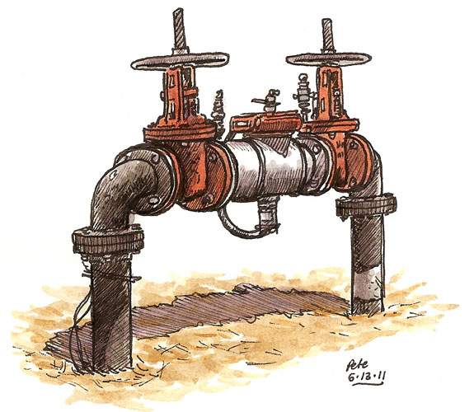
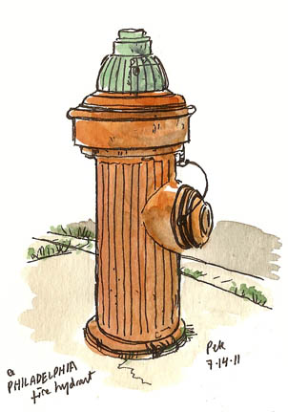
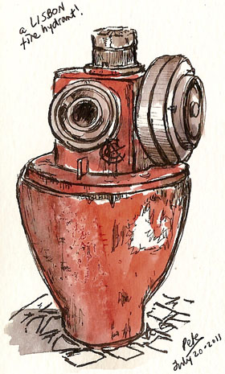
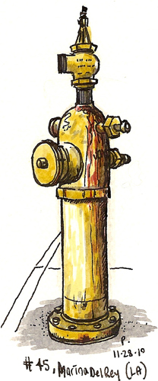
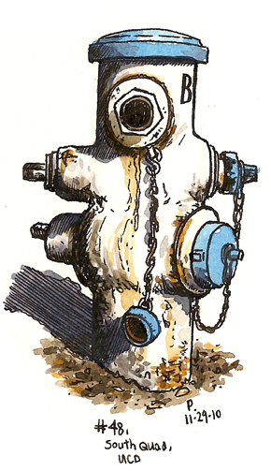
Fire Simulation Software
Carlos Gonzalez Garza

Slide 2
Objectives
European Building Regulations.
Combustion
Computational Fluid Dynamics
  Discretization Method
Software
CFD Case Study
  Ex-USS Shadwel
Fire Evaluation Case Study
  Underground Shoping Centre

Slide 3
European Regulations

Slide 4
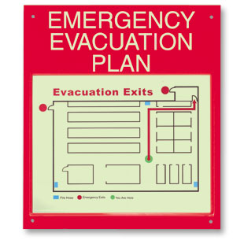
Protection of the health & safety of ALL building users
According to ISO FDIS 21542: ‘Building Construction – Accesibility & Usability of the Built Environment’.
10% of people have some sort of disability.
Its predicted that at somepoint the building will be at 120% of its capacity.

Slide 5
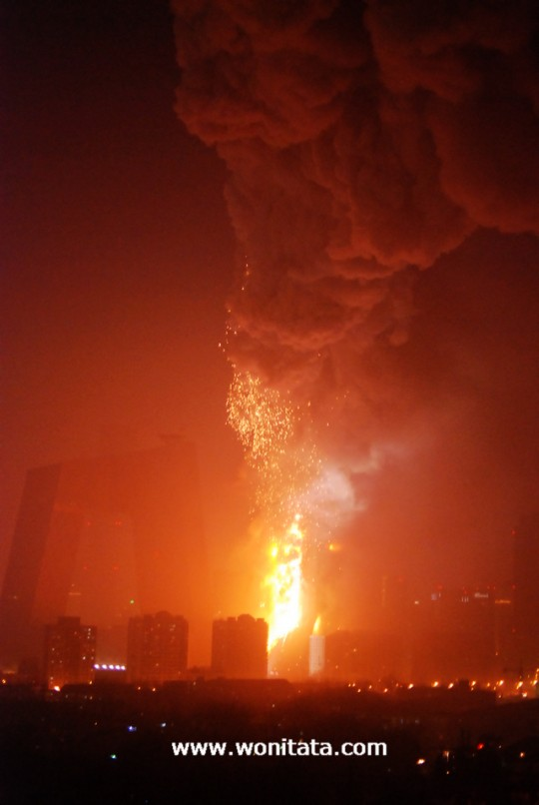
Protection of property.
Protection of the health & safety of emergency first response personnel.
Facility, cost of reconstruction, refurbishment and repair after fire.
Protection of the natural environment from smoke, pollution adverse impacts.

Slide 6
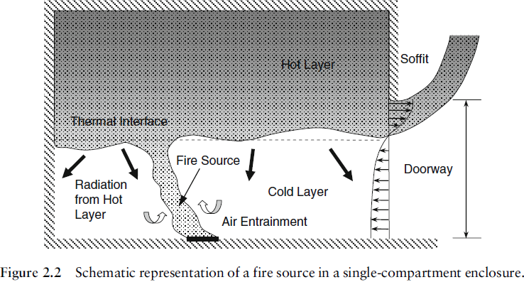
Combustion
Incipient Phase
  20 to 21%
  500 to 550 C
Free Burning Phase
  15 to 19%
  700 C
Smouldering Phase
  Less than 15%
  Above 550 C

Slide 7
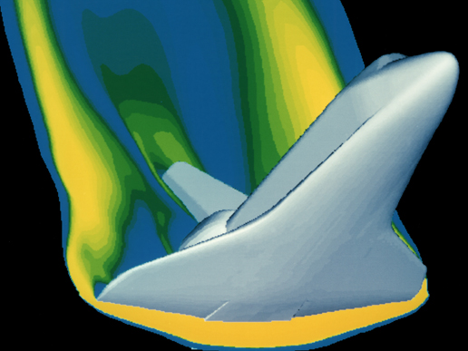
Computational Fluid Dynamics
CFD is the study of a fluid system that is varying statically or dynamically in function of space and time.
Used in:
  Aeronautics
  Automotive Industry
  Mechanical, electrical and environmental engineers
“A computer simulation of high velocity air flow around the Space Shuttle during re-entry.”[1]

Slide 8
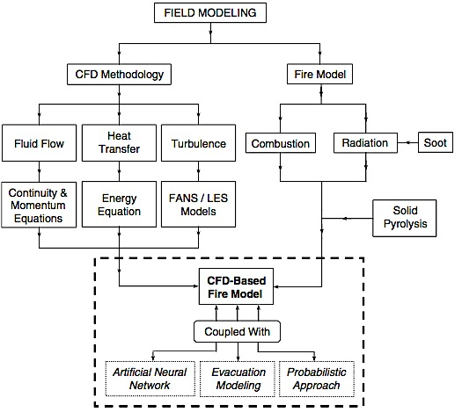
Field Modeling Approach
The physical characteristics of a fluid in motion can be described by the consideration of mathematical equations governing a process of interest.

Slide 9
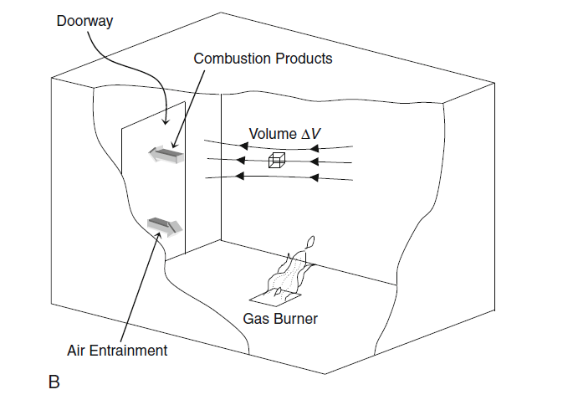
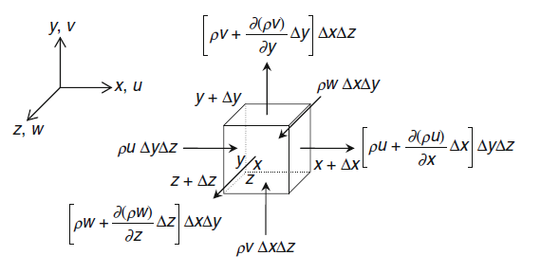
Discretization

Slide 10



Commercial Codes

Slide 11
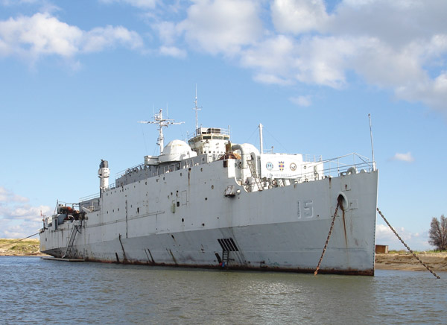
Ex-USS Shadwel

Slide 12
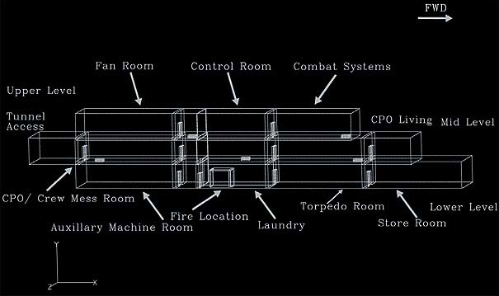
A schematic of the different compartments of the ex-USS Shadwel lrepresented in the numerical simulations.

Slide 13
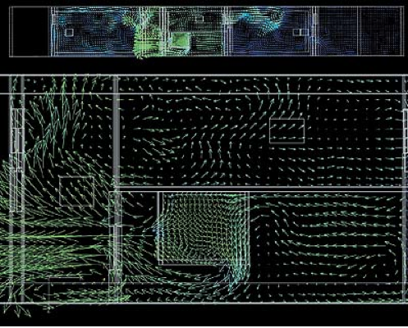
A detailed view using velocity vectors to illustrate the flow field in the laundry room and the adjacent passageway.

Slide 14
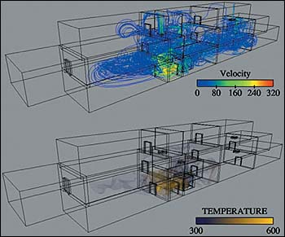
The simulated smoke spread within the ex-USS Shadwell shown using velocity (in cm/s) and temperature (in K) distributions.

Slide 15
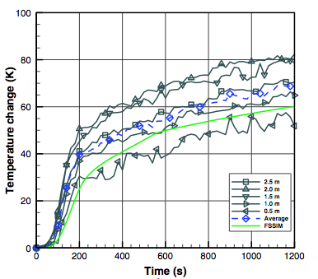
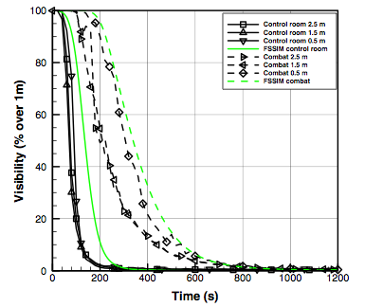
Results

Slide 16
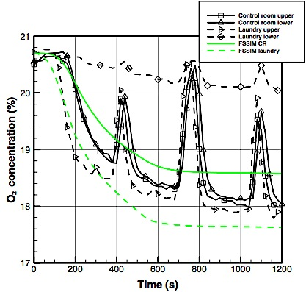

Slide 17
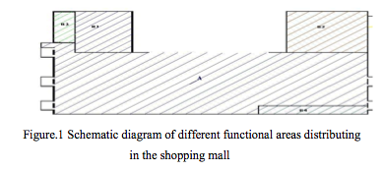
Fire Risk Evaluation Case Study
AREA | 21677 m^2
NET DEPTH | 6.3 m
LENGTH | 150 m
WIDTH | 147.77

Slide 18
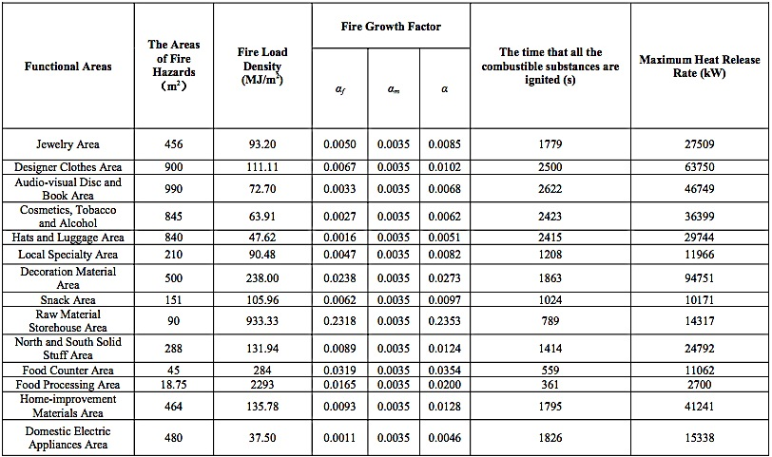
Fire Risk Evaluation Case Study Results
F. Table of parameters related to functional areas. {Ren, 2007}.

Slide 19
Fire Risk Evaluation Case Study Calculations
RSET
Trset = talarm+tresp+tmove
Where t alarm is the fire detection time.
t resp is the people reaction time.
t move is the movement time of evacuation.
Normally t alarm = 15s and t resp = 30s
t1 = t0 + s/v = t alarm + t resp + s/v
s is the distance that people have to walk to an emergency exit = 150 m
v is the velocity of evacuation
According to the author the result obtained is 309 second that means that ASET > RSET.

Slide 20
Corrective Measures

Slide 21

Conclusions
Data obtained can be used to,
Improve the building fabric.
Improve building air tightness.
Design the HVAC systems.
Design of lifts and emergency stairwells.

Slide 22
Any Questions?
Many Thanks ¡

